Slide 1
Chromatin Biology in Neurological Disorders
Cliff Rodgers
Notes:
- In the last two talks, Trina showed that epigenetic machinery
control the orderly acquisition and _maintenance_ of neuronal
traits. Sisi showed that epigenetics is involved in learning and
memory through a balance of genetic repression and
expression. Today we will ask, are cases of abnormal or disordered
neurological phenotype associated with malfunction in the
machinery that controls gene expression and chromatin
modification?

Slide 2

Epigenetics
Involves the regulation of gene expression without altering the underlying DNA sequence
Notes:
- Review epigenetics/role of transcriptional regulators like REST
and chromatin remodelers like G9a

Slide 3
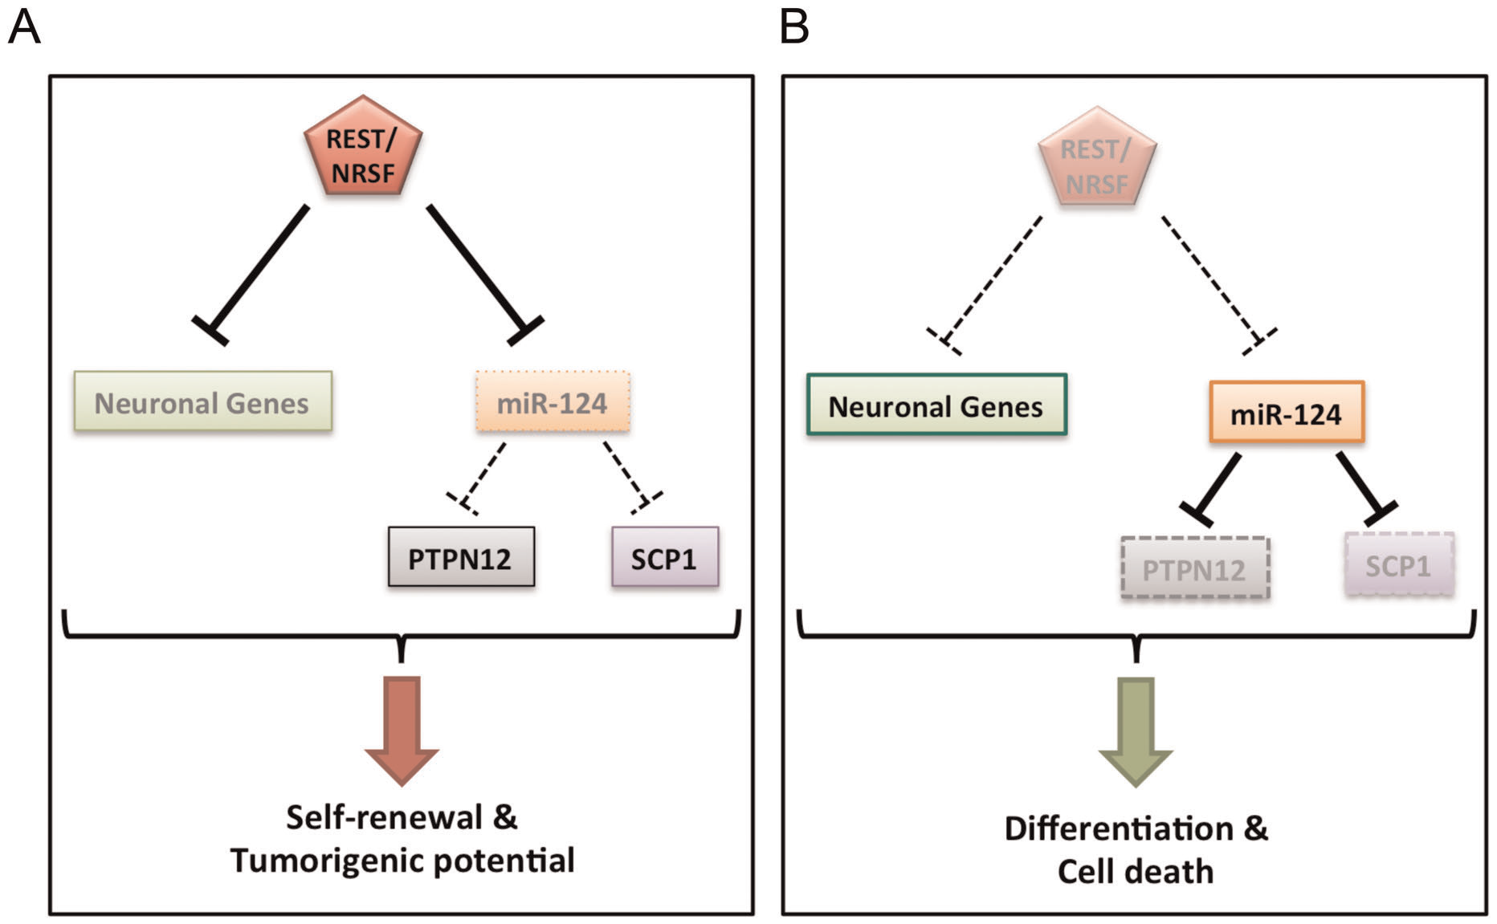
Glioblastoma multiforme
Involves glial cells
Accounts for 52% of all functional tissue brain tumor cases
20% of all intracranial tumors
Conti et al., 2012
Notes:
REST plays an oncogenic role in brain childhood
malignancies such as neuroblastoma and medulloblastoma. Recall, the
REST gene codes for a protein that binds regulatory regions in genes
(Neuron-restrictive silencer element, NRSE) and recruits enzymatic
chromatin-modyfing machinery such as HDAC (Histone Deacetylases)
to silence expression certain genes.
- Today we’re going to look at a specific type of brain cancer called Glioblastoma multiforme,
the most common and most aggressive malignant
primary brain tumor in humans,
- involving glial cells and accounting
for
52% of all functional tissue brain tumor cases and
20% of all
intracranial tumors.
This model shows the signalling pathways that Luciano Conti and colleagues investigate
in their 2012 report showing that REST controls the self-renewal and TUMORIGENIC COMPETENCE
of human glioblastoma cells. For the purposes of this talk we’ll focus on the left branch of the model.
So first things first, Luciano Conti and colleagues asked the question, “Is REST expressed in tissue from human gliablastoma multiforme specimens?”

Slide 4
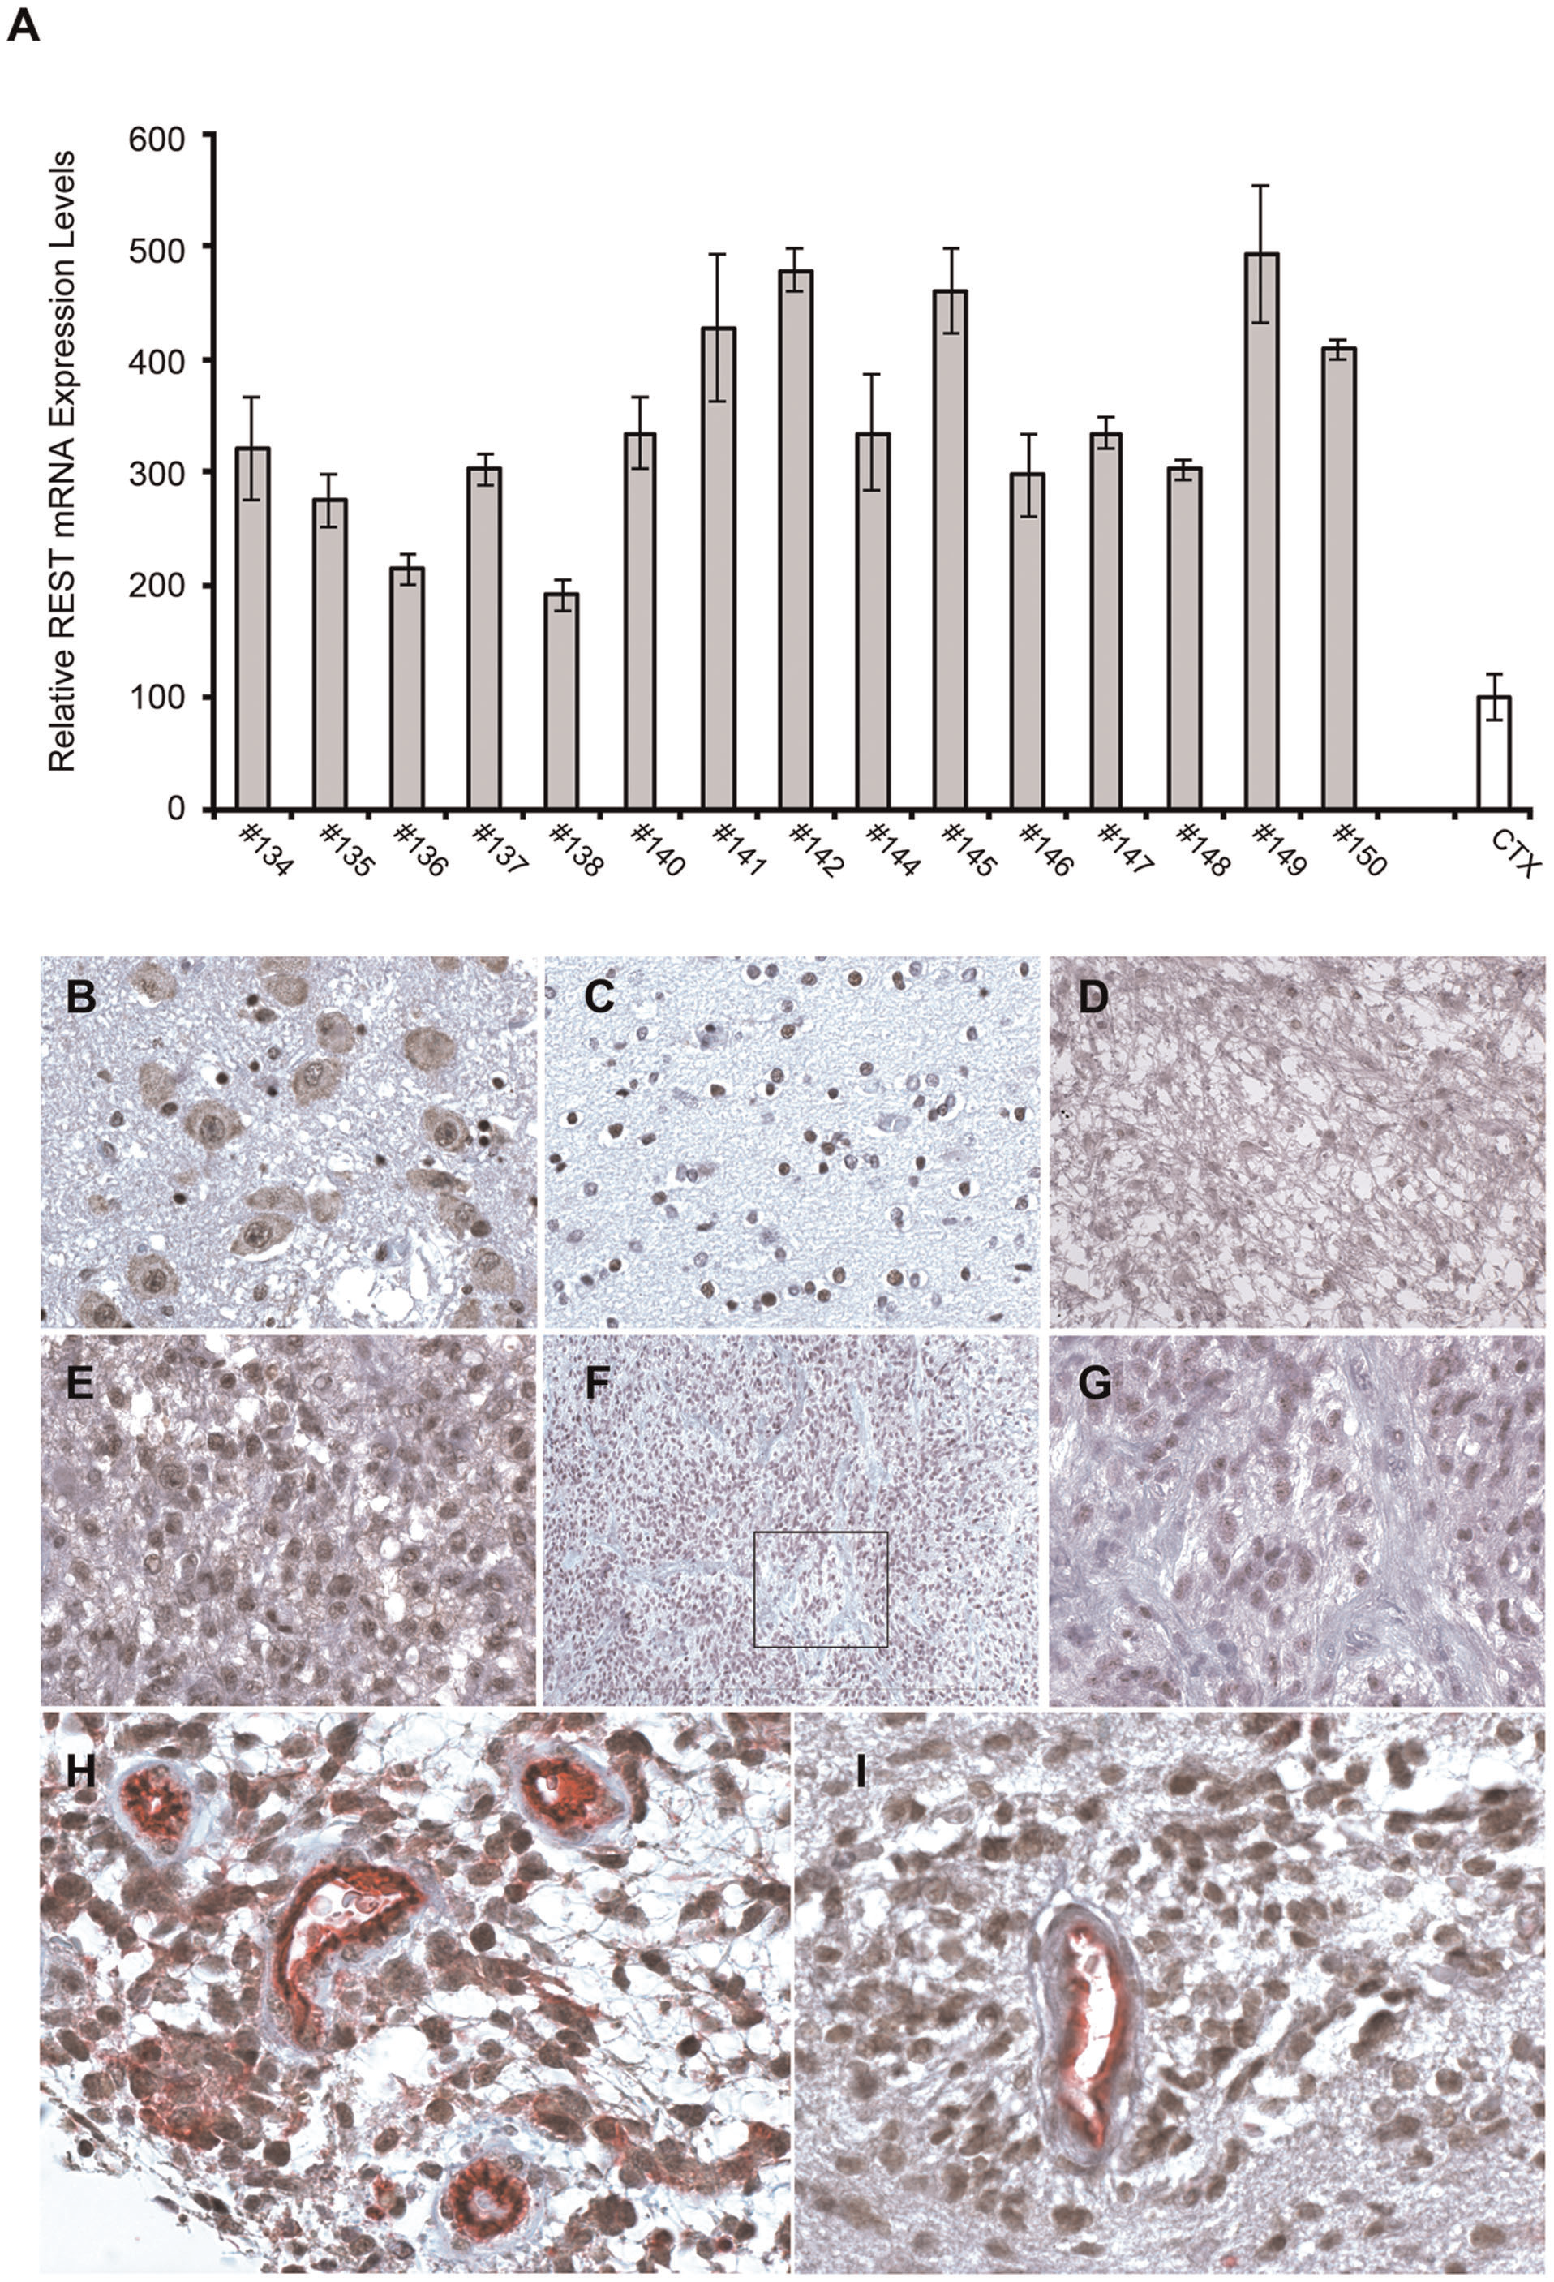
Is REST expressed in tissue from human glioblastoma multiforme specimens?
Conti et al., 2012
Notes:
Fig. 1A REST is expressed in tissue from human glioblastoma
multiforme at higher levels than tissue from normal human
cortex, looking at REST mRNA levels relative to GADPH
(Glyceraldehyde 3-phosphate dehydrogenase), a gene coding for a
Enzyme involved in glycolisis . Used quantitative RT-PCR
- Fig 1B, cells from pontine nuclei of "control specimens" show
nuclear and cytoplasmic immuno-staining for REST. It’s
important to note here that the authors have taken no steps
to discriminate between neural and glial cells with this
staining protocol, so presumably they are staining a
mixture of cell-types here.
- Fig 1E, nuclei of proliferating glioblastoma cells stain
intensely positive for REST, AND THE AUTHORS argue that this discrepancy
reflects an epigenetic mechanism affecting the trafficking of
REST to the nucleus, allowing it do its thing, silencing gene
expression.
- So yes, REST is expressed in the glioblastoma tissue. ” The
authors actually take tissue from some of the human samples
showing high REST expression levels and go on to investigates
its properties. Recalling the model I showed earlier, the
researchers ask “What is REST’s role in the self-renewal and
tumorigenic competence of glioblastoma cells in vitro and in
vivo?”

Slide 5
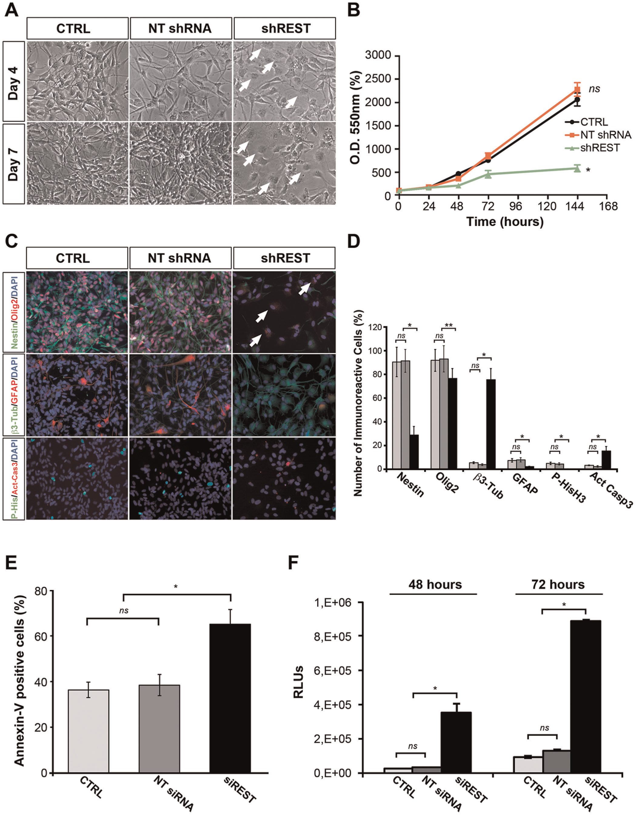
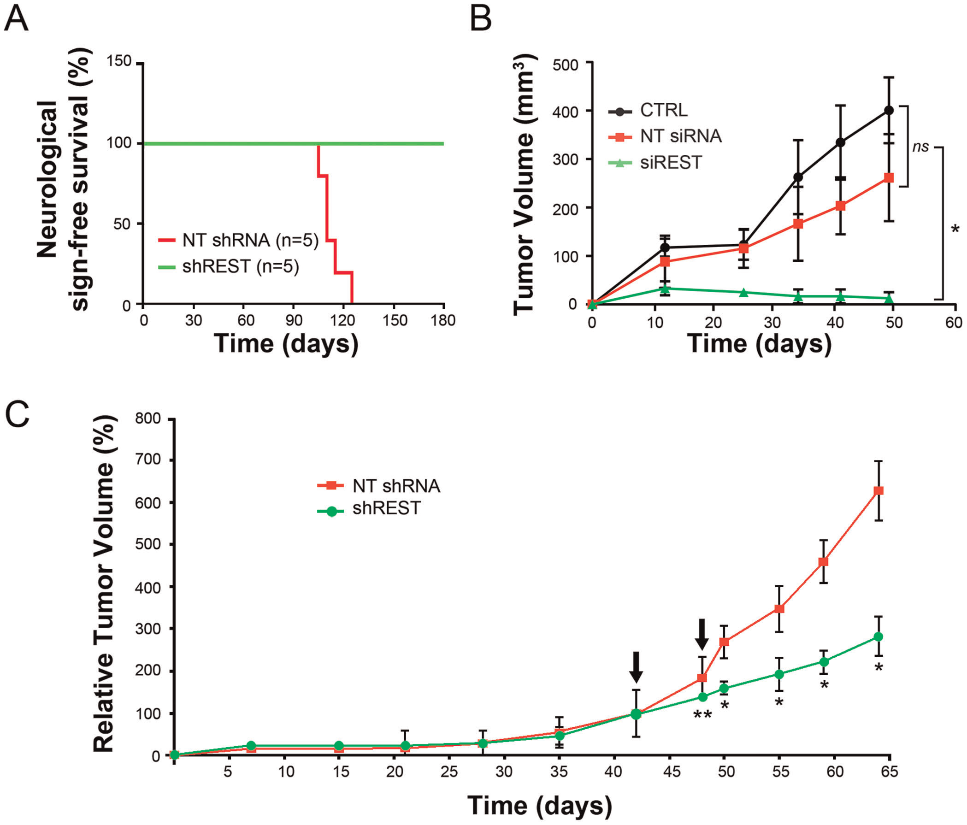
What is REST’s role in the self-renewal and tumorigenic competence of glioblastoma
in vitro?
in vivo?
CTRL
NT shRNA
shREST
Optical Density
Conti et al., 2012
Notes:
- /In vitro/ they culture cells from these tumors and show that
REST is upregulated in them, the authors then ask the question,
will knockdown of REST affect the self-renewal and tumorigenic
competence of these cells. Panel B, REST knockdown impairs
self-renewal in these cultured glioblastoma cells (green line)
relative to control cells (black) and cells treated with
non-targeting shRNA (red).
You’ll recall that Trina showed how these small strands of RNA
that bind a particular transcript and degrade or otherwise
prevent it from being expressed
In Panel D, REST knockdown reduces
expression of neural progenitor (Nestin) and proliferation
(PHis-H3) and increases markers of differentiation (β3-tubulin)
and apoptosis (Activated Caspase 3) (black bars), compared to
control cells (light) and cells treated with non-targeting shRNA
(grey).
- /In vivo/ mouse model: will the delivery of REST-specific shRNA
(RNA interference) affect tumorigenic capability? Fig 4, A and B
Immunocompromised mice implanted with glioblastoma cells from
human cell lines previously transduced with shREST or non targeting shRNA
show better survival for tumors in which REST was knocked down
and decreased tumor volume compared to nontargeting siRNA and
control animals transplanted with noninfected glioblastoma
cells. Fig 4C: intra-tumoral injection of REST shRNA impairs
established tumor growth in mice relative to nontargeting shRNA.
Cool: novel therapeutic target to prevent malignant brain tumor.
And a similar epigenetic mechanism to the one elucidated in the first talk
seems to be responsible for tumorigenic competence. Rather than using harmful
Radiation treatment or chemotherapy, or targeting downstream signaling cascades,
This model gives a novel UPSTREAM therapeutic target.
Next we’ll look at a disease in which trafficking of REST seems to play a role in maladaptive phenotype.

Slide 6

Huntington’s Disease
CAGCAGCAGCAGCAGCAGCAGCAG... → polyglutamine
HD
WT
Disturbances in
Motor Function
Cognitive Function
Psychiatric Function
Strong inheritance
Terminal. No cure.
From Thompson, 2003, Nature Genetics
Notes:
Huntington disease is one of a variety triplet repeat diseases caused
by CAG repeat expansion in the coding region of a given gene
(trinucleotide cytosine, adenine, guanine repeats that are translated
into a series of glutamine resides; Zoghbi & Orr, 2000 review).
The
products of these mutated genes have a glutamine stretch that, when
expanded, causes a dominant neurodegenerative disease, and each
product results in a unique, but overlapping, pattern of neuronal
loss.
- Huntington disease, characterized by disturbances in motor,
cognitive, and psychiatric function, is caused by a polyglutamine
repeat expansion in huntingtin a protein with largely unknown
function.
- Huntington disease typically affects individuals 35-50
years of age and is terminal. There is no cure.
- This schematic shows the interactions of WT on the left and
mutant huntingtin protein on the right with REST and its binding
site. Chiara Zuccato and her coinvestigators looked at whether
huntingtin protein interacts with with REST/NRSF to modulate the
transcription of NRSE-controlled neuronal genes. For this report
it’s important to note that
Chiara Zuccatto’s group has
previously shown that WT but not mutant huntingtin stimulates
the transcription of BDNF BDNF is one of these genes under
regulation by REST because its promoter region has a binding
site for REST. Its expression is critical for normal neural
function. We're going to focus on it for this part of my talk.

Slide 7
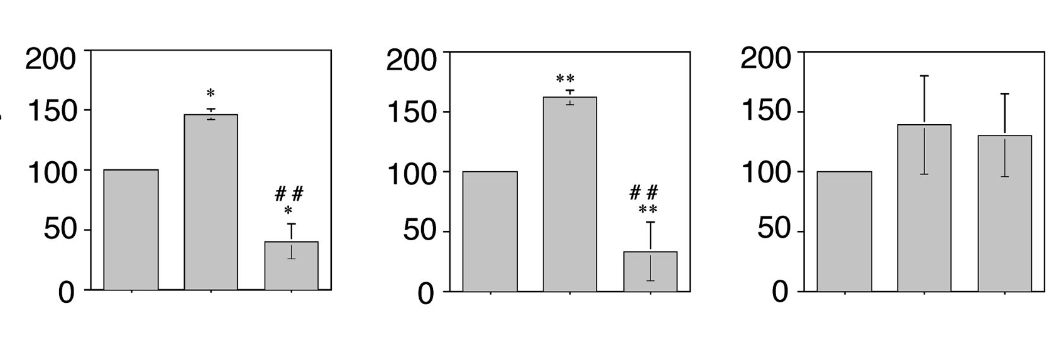
How does WT but not mutant huntingtin stimulate the transcription of BDNF?
BDNF with inactive
REST Binding Site
BDNF
REST Binding Site
HD
WT
Promoter activity
Parent
--------------------
↑WT huntingtin
--------------------
↑Mutant huntingtin
Parent
--------------------
↑WT huntingtin
--------------------
↑Mutant huntingtin
Parent
--------------------
↑WT huntingtin
--------------------
↑Mutant huntingtin
Zuccato et al., 2003
Notes:
Chiara Zuccato and her colleagues start out by asking just that question.
- Fig. 1 A, B, C: subclones of ST14A embryonic neural cells
overexpressing wildtype huntingtin show elevated
promoter activity in the gene coding for BDNF relative to a nominal level in the parental cells.
This is presumably due to some nominal level of BDNF suppression in the parental cells that is reduced when you overexpress WT huntingtin.
They also show reduced promoter activity in
cells overexpressing mutant huntingtin relative to parental
cells in the BDNF promoter, and B, a construct containing the
REST binding site from the BDNF promoter alone fused to a
different promoter shows that the huntingtin’s effect on promoter
activity in the previous box is indeed due to an interaction between REST and its binding site. (It has to be said that this reduction in activity could indicate a dominant negative effect of Mutant huntingtin on WT huntingtin activity because the cells express some nominal level of WT huntingtin and the promoter activity was reduced rather than held at a similar level to the parental
Cells. Sisi examined similar dominant negative effects in mutated phenotypes last week. The authors Didn’t look at this effect, and it hasn’t been shown in other experiments to my knowledge, but it seems like a real phenomenon
Worth investigating.)
And C, when you mutate the REST binding site
to render it nonfunctional, you don't see a difference in
huntingtin activity.
Taken together these lines of evidence show an interaction between WT and mutated huntingtin, REST and REST’s binding site to repress genes like BDNF that contain REST binding sites in their promoter regions.
RED circles

Slide 8

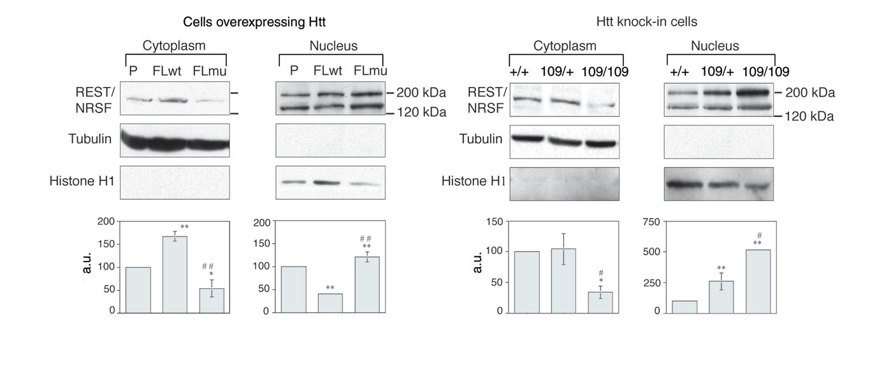
How does WT huntingtin target the REST binding site to promote transcription of BDNF?
HD
WT
Zuccato et al., 2003
Notes:
- Fig 3A, This IS a Western blot. Cytoplasmic recruitment of REST in
cultured neural cells. They go on to show that WT huntingin
enhances activity at REST's binding site by recruiting REST to
the nucleus (the second band in the nuclear REST signal suggests
post-translational modifications of REST, and has been
previously shown) and
Fig. 3B in cells cultured from mutant mice
with a knock-in 109 CAG repeat inserted into the gene coding for
huntingtin, showing decreased levels of REST in the cytoplasm in
cells from homozygous huntintin mutants and increased levels of
REST in the nucleus. The WT mouse has 7 CAG in the gene coding
For huntingtin protein
- They’ve shown that WT huntingtin sequesters REST to the cytosol, preventing it from interacting with its binding site in the nucleus. They go on to show that an interaction between REST and WT huntingtin occurs in the cytoplasm of neural cells of mice and this is the first demonstration of such an interaction. They also later go on to show that this occurs in tissue samples from human patients with Huntington’s disease. Therefore, Chiara Zuccato and colleagues propose that in Huntington
disease, neuronal genes with NRSEs, such as /BDNF/, are expressed at
lower levels due to the presence of mutant huntingtin instead of two
intact copies of WT huntingtin. Without normal levels of WT
huntingtin to bind REST in the cytosol, more REST, the silencing
factor, can enter the nucleus and repress transcription.
As the previous two talks showed us it does so by recruiting HDACs to deacetylate nucleosomes
And this is cool because it represents an epigenetic model of Huntington’s disease, providing possible therapeutic targets for a previously untreatable disease. In fact, human treatment studies conducted by this same group are looking at using an HDAC inhibitor called SAHA to treat Huntington’s disease.
Next we’re going to look at a different disease that seems to be linked to disregulation of BDNF expression, and you guessed it REST seems to be involved.

Slide 9
Epilepsy Ketogenic Diet
Recurrent seizures
More than 50 million people worldwide
Ketogenic diet
Low Carbs
High protein, fat
Notes:
We'll continue looking at BDNF's regulation by REST and it's
potential role in elucidating the mechanism by which the
ketogenic diet ameliorates certain types of epilepsy.
Epilepsies, disorders characterized by recurrent seizures,
affect ≈ 1% of the world population (More than 50 million people; Zhong Huang &
McNamara, 2006; Garriga-Canut et al., 2006). About 1/3rd of those people
have seizures that do not respond to optimal therapy with available
antiepileptic drugs.
- A ketogenic diet, low in carbohydrates and high
in fat, reduces seizure frequency in some patients with severe
epilepsy, and is used as an alternative therapy for drug-resistant
epilepsy. The mechanism by which the ketogenic diet inhibits seizures
is uncertain.
GET BETTER FIGURE FROM AVTAR

Slide 10










Genes involved in:
Learning $ Memory
Epilepsy (BDNF & TrkB)
Cancer
Huntington’s Chorea
Cardiac Hypertrophy
Transcription
REST
CtBP
This represents a direct link between carbohydrate metabolism and the regulation of genes important in epilepsy.
ATP
ATP
ATP
NAD
ATP
ATP
NADH
Oxidative Respiration
Glucose
Pyruvate
ADP
ATP
2DG
Courtesy Avtar Roopra
Notes:
- Because the ketogenic diet involves restriction of carbohydrates,
Mireia Garriga-Canut and colleagues hypothesized that glycolisis might be a
mechanism by which the diet exerts its antiepileptic effects
(Garriga-Canut et al., 2006). Specifically they hypothesize that the use of a
glycolitic inhibitor (2-Deoxy-D-glucose; 2DG) will protect against seizure
Gene transcription patterns are controlled by TFs that recruit chromatin modifyers.
REST is a factor that controls upwards of 1800 genes -many of which are neuron specific,
Such as BDNF.
Glucose metabolism is an important source of
ATP, the energy currency of the cell,
via the process of oxidative respiration
The products of glucose metabolism can affect REST’s ability to
suppress gene expression
Many of these REST-controlled genes are up-regulated in breast, colon, prostate cancers and in this case Epilepsy.
This represents a direct link between carbohydrate metabolism and the regulation of genes
like BDNF which are important in epilepsy. So this may be a mechanism by which the reduction of carbohydrates In the diet can affect seizure severity.
- To test this hypothesis, the authors use an inhibitor of glucose metabolism, 2DG. And they ask,

Slide 11
How does 2DG exert antiepileptic effects?
Garriga-Canut et al., 2006
Notes:
- Fig. 1 A, B, C, A: rats treated with 2DG have a higher
afterdischarge threshold compared to saline treated animals. A
reduction in after discharge threshold leads to an increase the
kindling of epilepsy, so a reduction means more epilepsy. The kindling model of epilepsy is a commonly used paradigm that involves repeated electrical stimulation of the brain to evoke seizures
B:
rats treated with 2DG require more after discharges
(i.e. stimulations) to evoke various classes of behavioral
seizures in increasing severity.
- C: quantitative real-time PCR
shows increased BDNF expression (relative to actin expression)
in saline but not 2DG treated kindled animals after 2 weeks or
until 5 after discharges but not in the case of severe
behavioral seizures.
Cut off class V

Slide 12
Transcription
REST
CtBP
ATP
ATP
ATP
NAD
ATP
ATP
NADH
Oxidative Respiration
Glucose
Pyruvate
ADP
ATP
2DG
Courtesy Avtar Roopra
Notes:
- So they’ve shown that 2DG can suppress the transcription of BDNF following the kindling of epilepsy in this animal model.

Slide 13
How does 2DG affect transcriptional regulation to reduce BDNF gene expression?
REST
Garriga-Canut et al., 2006
Notes:
2DG reduces REST binding to the REST binding site in the
promoter region for BDNF as indicated by chromatin
immunoprecipitation in cells from animals who have been
kindled and treated with 2dg They’re looking at antibodies for sequences
at or around the REST binding site of the BDNFs that have an Antibody
that can detect acetylation of H3K9 bound
to the antibody for the REST binding site or flanking sites.
It indicates that there is less acetylation around the REST
binding site, presumably because REST is bound and doing
its thing, recruiting HDACs.
Specifically it accomplishes this by increasing
methylation at H3K9 as you can see in the inset (a histone methylation site associated with
activating repressed genes), thus rolling the DNA along the
barrel-like histones into the heterochromatin and silencing
their expression.
And in B they show that REST is indeed bound
to its binding site in BDNF promoter gene. And that is
Consistent with the model I just described. This finding was
Important to support their model in which glycolisis affects REST’s
Recruitment of cofactors to suppress transcription.

Slide 14
Genes involved in:
Learning $ Memory
Epilepsy (BDNF & TrkB)
Cancer
Huntington’s Chorea
Cardiac Hypertrophy
Transcription
REST
CtBP
ATP
ATP
ATP
NAD
ATP
ATP
NADH
Oxidative Respiration
Glucose
Pyruvate
ADP
ATP
2DG
Courtesy Avtar Roopra
Notes:
So they have shown that 2dg, an inhibitor of glucose metabolism can
reduce the upregulation of BDNF expression seen in epilepsy
Cool: So this is nice because it
Presents a novel mechanistic model for a dietary treatment for epilepsy.
Researchers have gone on to look at a
REST KO mouse – 2dg has no effect.
We’ve belabored this transcriptional regulator enough,
let’s look at a chromatin remodeler, lysine dimethyltransferase
G9a that works by affecting the methylation state of histone H3 lysine number 9

Slide 15
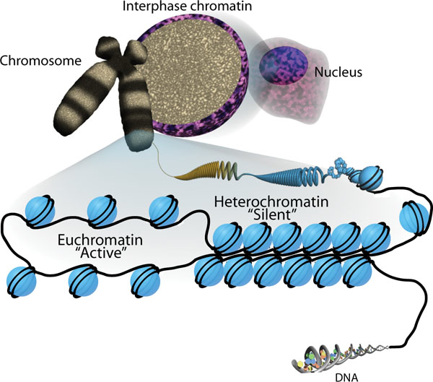
Euchromatin
Loose compaction of nucleosomes allows transcriptional access to DNA
Heterochromatin
Tight compaction of nucleosomes prevents transcription of genes
Sha & Boyer, 2009
Notes:
http://www.stembook.org/sites/default/files/pubnode/9f82a6e695df6084e39d3197b7a575c2f95316e9/The_chromatin_signature/Sha01.jpg
Recall that there are two types of chromatin.
Euchromatin contains mainly expressed, active genes and heterochromatin contains mainly repressed silent genes. And the acetylation/methylation state of histone tails, like histone H3 lysine number 9 controls whether chromatin is unrolled, largely available for transcription, or rolled up, and largely silenced.

Slide 16

?
G9a
H3K9
From wikipedia.org
Notes:
- It was previously shown through genome-wide promoter analysis that repeated cocaine administration alters the pattern of histone H3 lysine 9 methylation at specific genes (I think immediate early genes like Delta FosB) in the Nucleus Accumbens, an important component of the brain’s reward circuitry.
- G9a is a chromatin remodeler that modifies the chromatin architecture to rotate the DNA bound around histones, controlling repression or expression of genes. G9a is known to methylate lysine number 9 on histone H3, causing DNA to wind up.
- Ian Maze and coauthors investigate a
Role for H3K9 methylation and lysine dimethyltransferase G9a
in cocaine-induced plasticity.

Slide 17
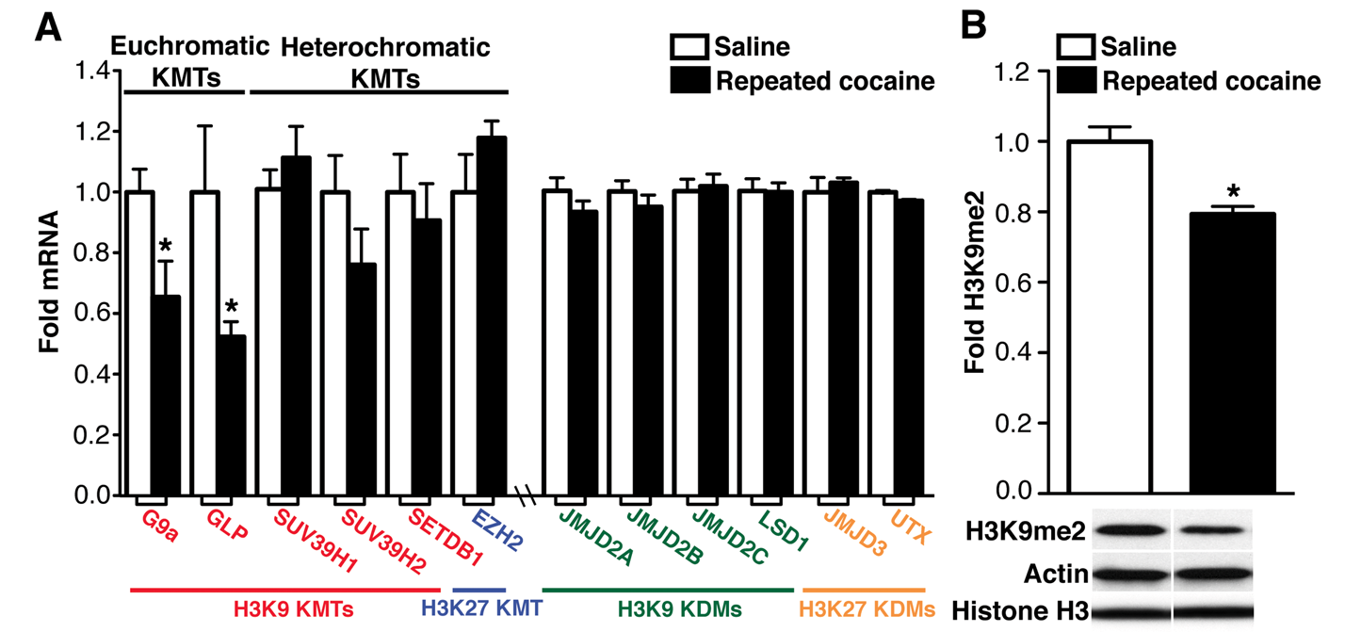
Does G9a expression correlate with repeated cocaine administration?
Maze et al., 2010
Notes:
- Fig. 1A: Profiled mRNA levels of lysine methyltransferases and
lysine demethylases, and saw that G9a and another chromatin
remodeler were downregualted in animals who have received repeated cocaine administration
- Fig 1B: And this correlates with reduced H3K9 methylation.
So repeated cocaine administration affects the methylation state of H3K9 and seems to involve regulation of G9a

Slide 18
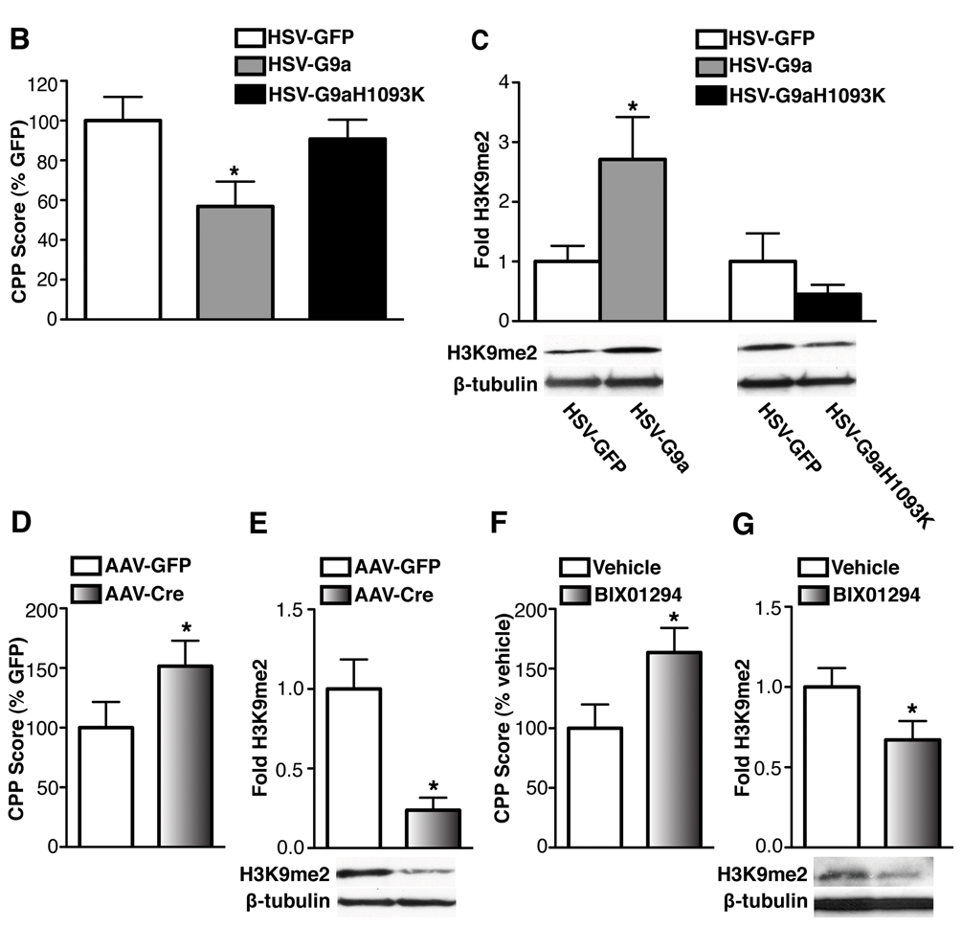
How does G9a expression (in nucleus accumbens) regulate behavioral response to cocaine?
G9a
↓G9a
↑G9a
↓G9a
↑H3K9
H3K9
↓H3K9
↓CPP
CPP
↑CPP
Maze et al., 2010
Notes:
ADD MINI SCHEMATIC TO WALK THROUGH THE EFFECT
- Fig 2B, C: viral overexpression of G9a significantly decreases place
preference for cocaine and also increases methylation of histone
H3K9.
Conditioned place preference involves associating
A stimulus with one of two chambers and allowing the animal to move freely
Between the two chambers. If the stimulus is preferred, the animal will spend
More time in the chamber that was associated with the rewarding stimulus,
Such as repeated cocaine administration. In this case conditioned place preference
Is expressed relative to control animals receiving virus and GFP.
- A catalytically dead form of G9a does
not decrease place preference or H3K9 methylation
- Fig 2D, E, F, G: AAV-Cre knockdown of G9a in nucleus accumbens
significantly increased the effects of cocaine in place
conditioning experiments and decreased levels of methylated H3K9
in nucleus accumbens. Using a pharmacological inhibitor of G9a,
BIX01294, they demonstrated that pharmacological inhibition of
G9a significantly increased preference for cocaine and decreased
methylated H3K9 in nucleus accumbens.

Slide 19
G9a
H3K9
From wikipedia.org
Notes:
So their evidence is consistent with repeated cocaine administration downregulating G9a expression in nucleus accumbens and thus decreasing the methylation state of H3K9, thus unraveling the DNA wrapped around histones, allowing for gene expression.
- Cool: Histone methylation's role in long-term actions of cocaine. A epigenetic mechanism involved in behavioral and structural plasticity.

Slide 20
Summary
Epigenetic machinery involved in regulation of development and plasticity
“When REST goes WRONG” → Disorder and disease reign.
Novel therapeutic targets
Notes:
We saw a new mechanism by which epigenetic factors control addictive behavior and could potentially be targeted to treat it.
- In the case of brain cancer, we saw an upstream target that is potentially less deleterious than radiation treatment
- In huntington’s disease we saw a novel role for huntingtin protein that may provide new therapeutic strategies for an untreatable disease
We saw a potentital mechanism by which a 100 year old folk remedy for epilepsy achieves its effects ADD AVTAR’S MODEL

Slide 21
Thanks
Faculty Sponsor: Avtar Roopra
Trina Basu
Robin Fropf
Taehee Kim
Christian La
Sisi Li
Princess Ojiaku
Annie Racine
Aditya Rayasam
Katie Ricks
David Ruhl
Miguel Santiago Medina
Annie Tanenhaus
Scott Vermilyea
Samantha Wright
Brittany Young

